Slide 1

18 Nov 2025
Welcome to Solidity Summit 2025!

Slide 2

18 Nov 2025
3rd in person (4th overall) edition of Solidity Summit

Slide 3

Single-day forum for advanced Solidity discussions.
The Solidity Summit is a collaborative event focusing on the future of Solidity.
During the event you can expect to:
Get up to speed with the latest language proposals and new features.
Hear updates from Solidity dapp devs, tooling and security experts.
Learn from Solidity power users.

Slide 4
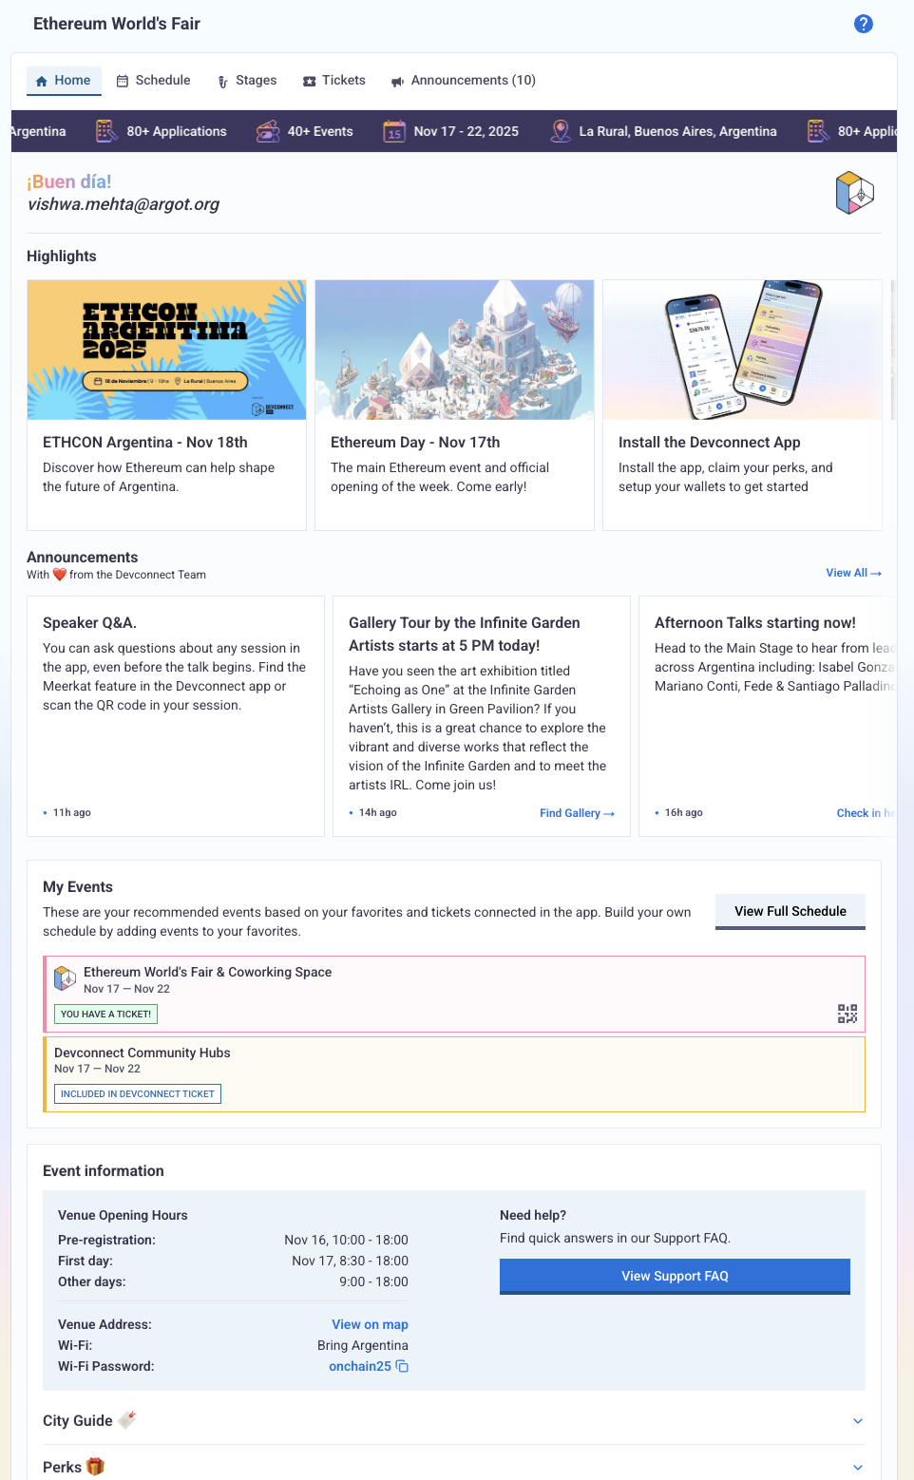
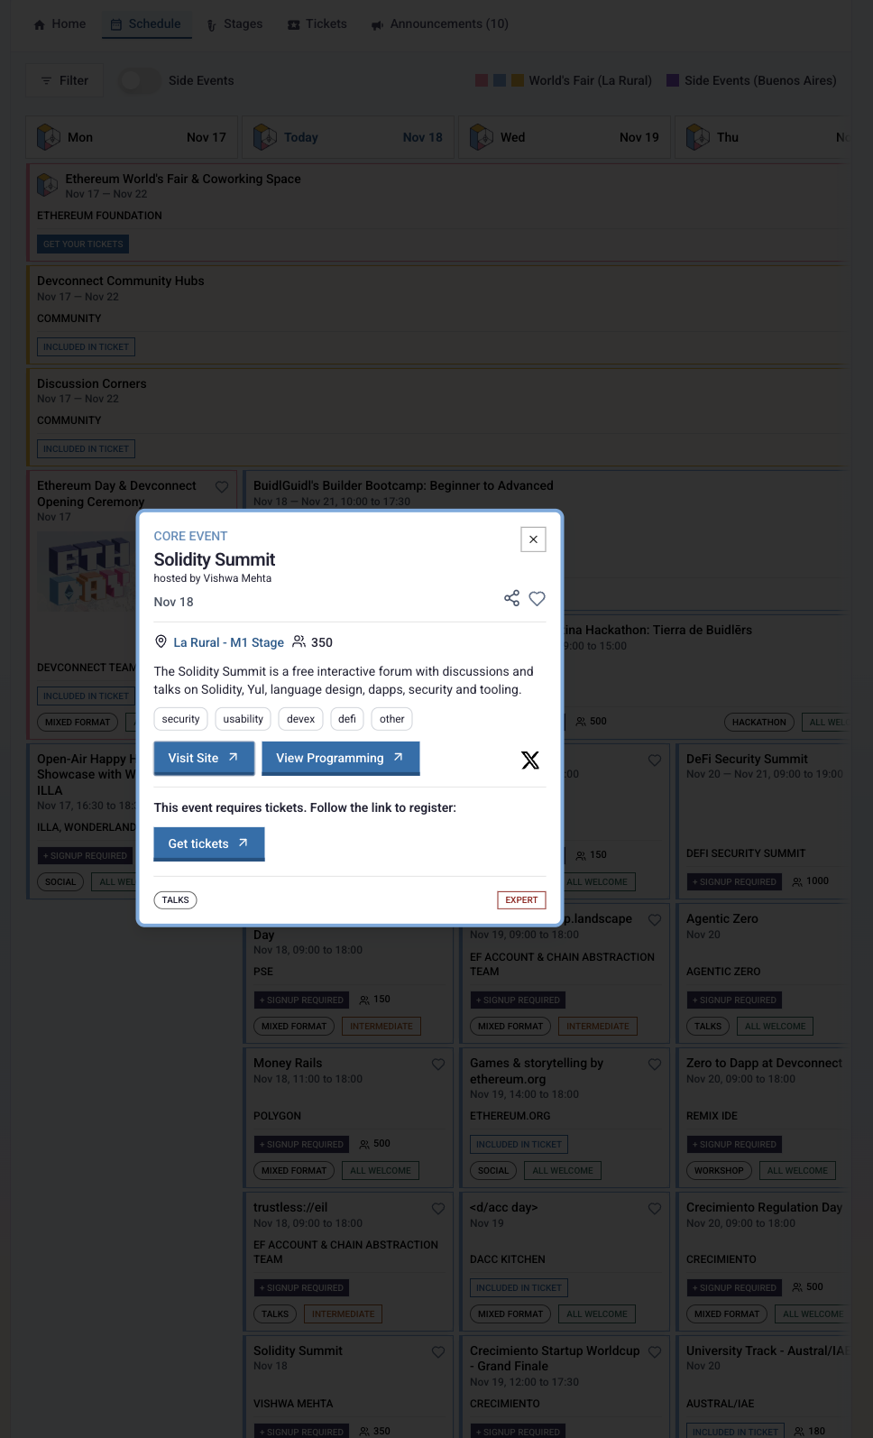
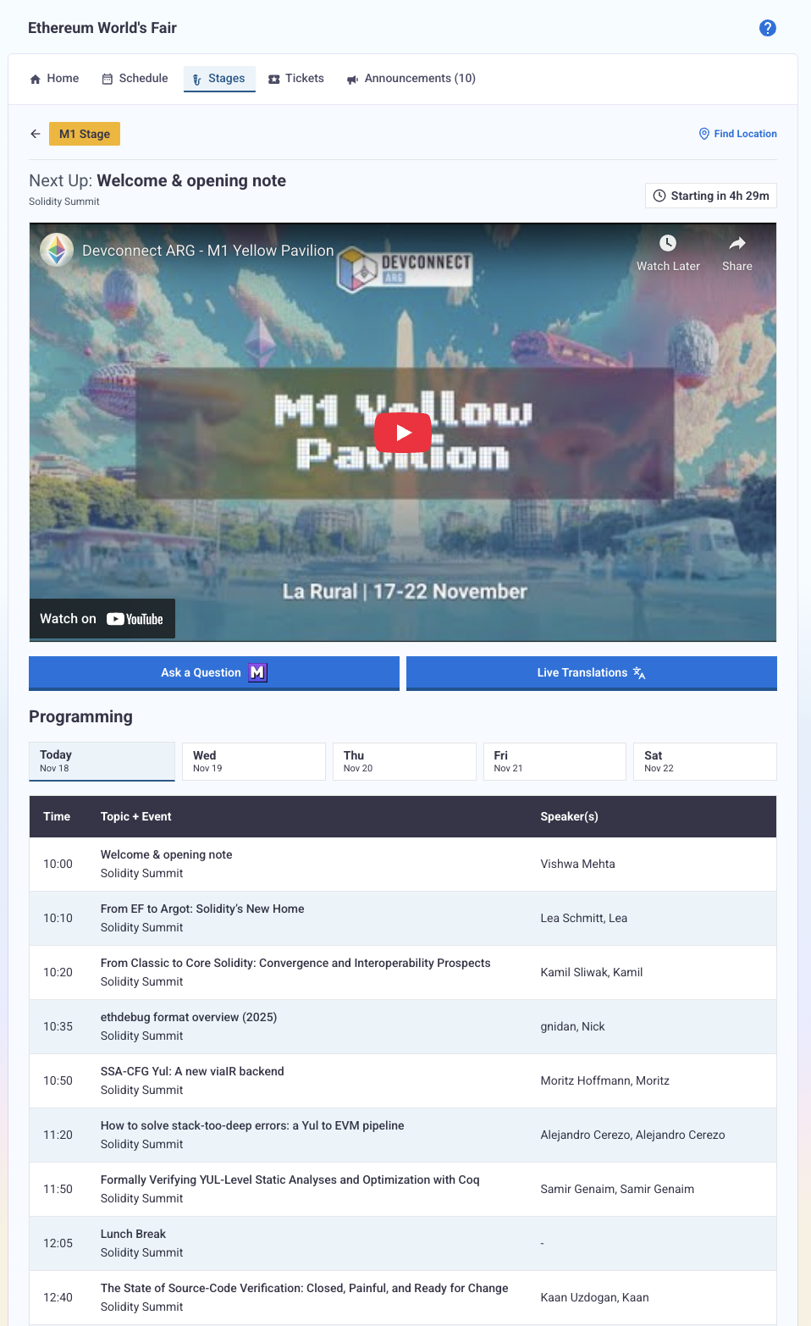

https://app.devconnect.org/stages/m1

Slide 5
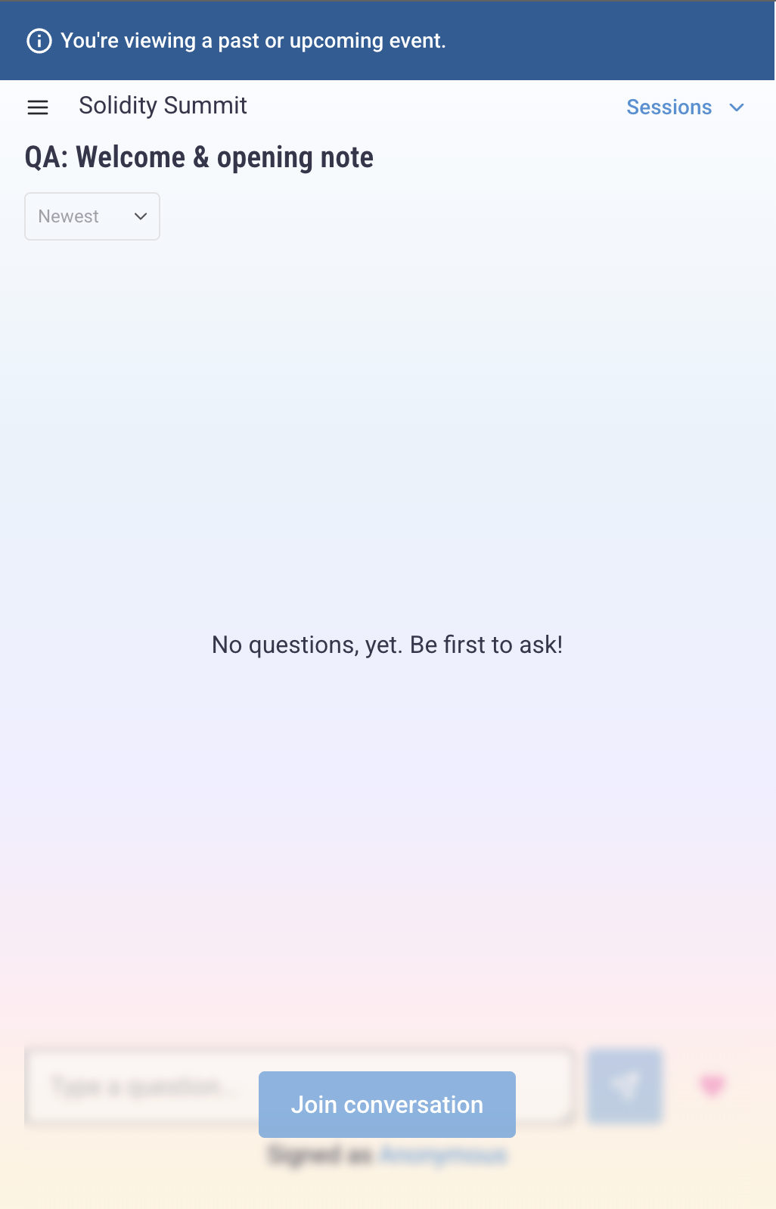
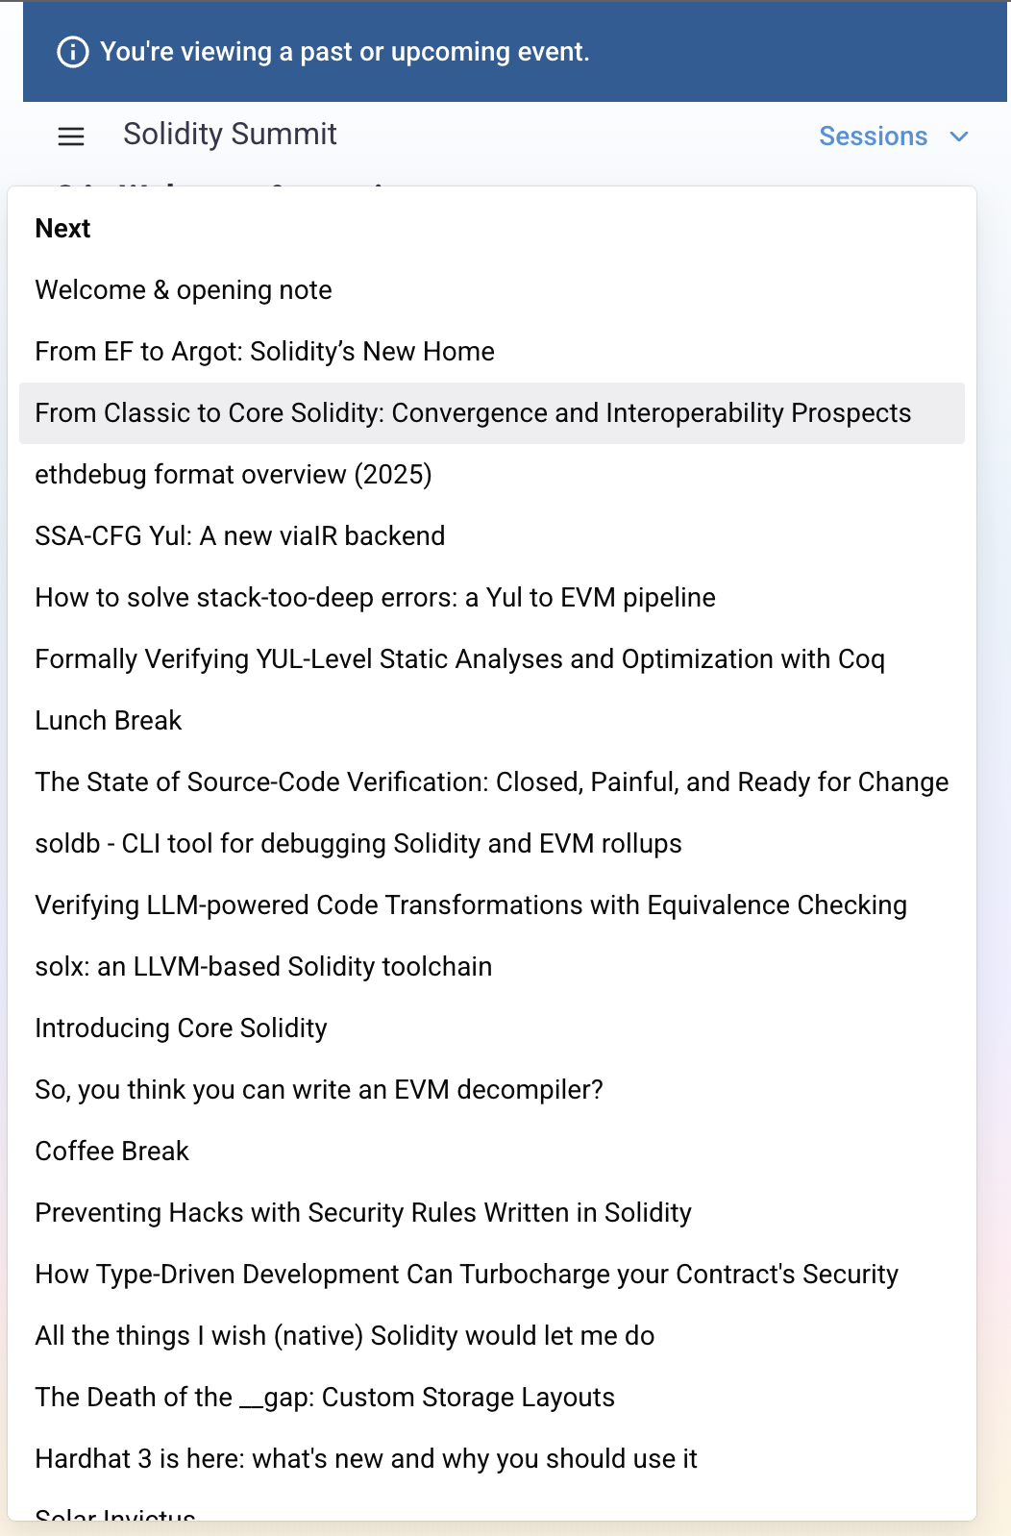
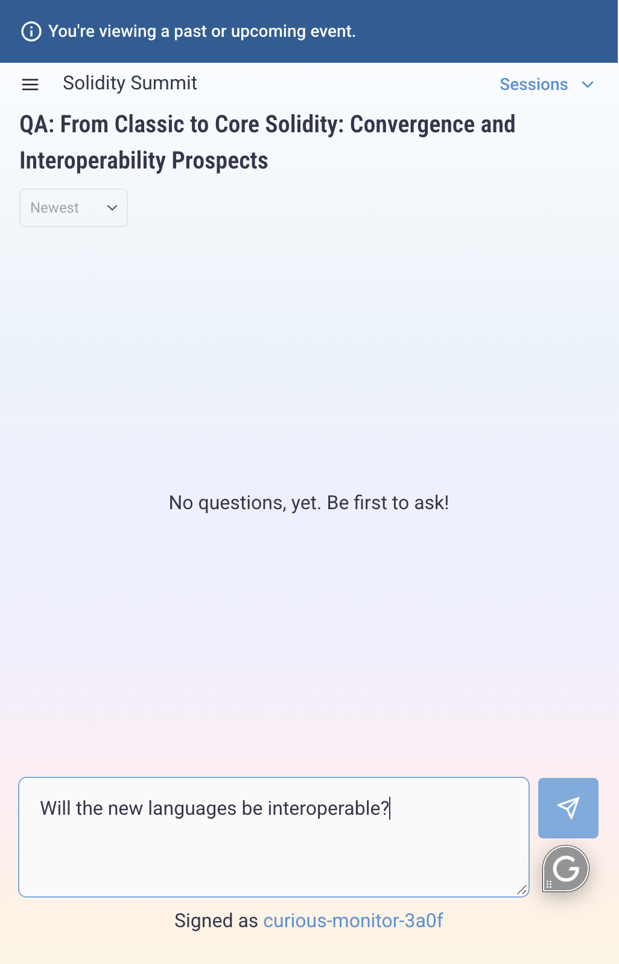
https://app.meerkat.events/e/1-solidity-summit/qa

Slide 6
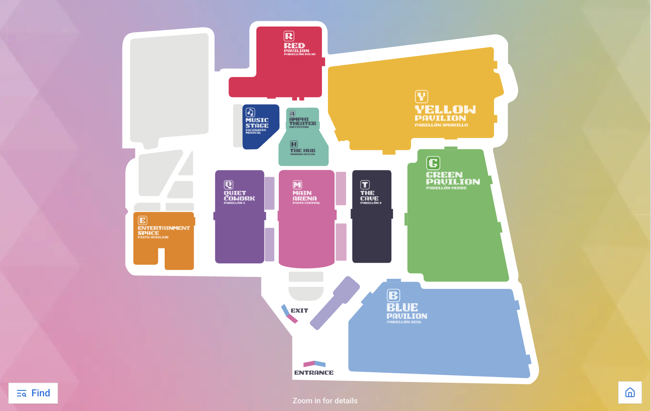
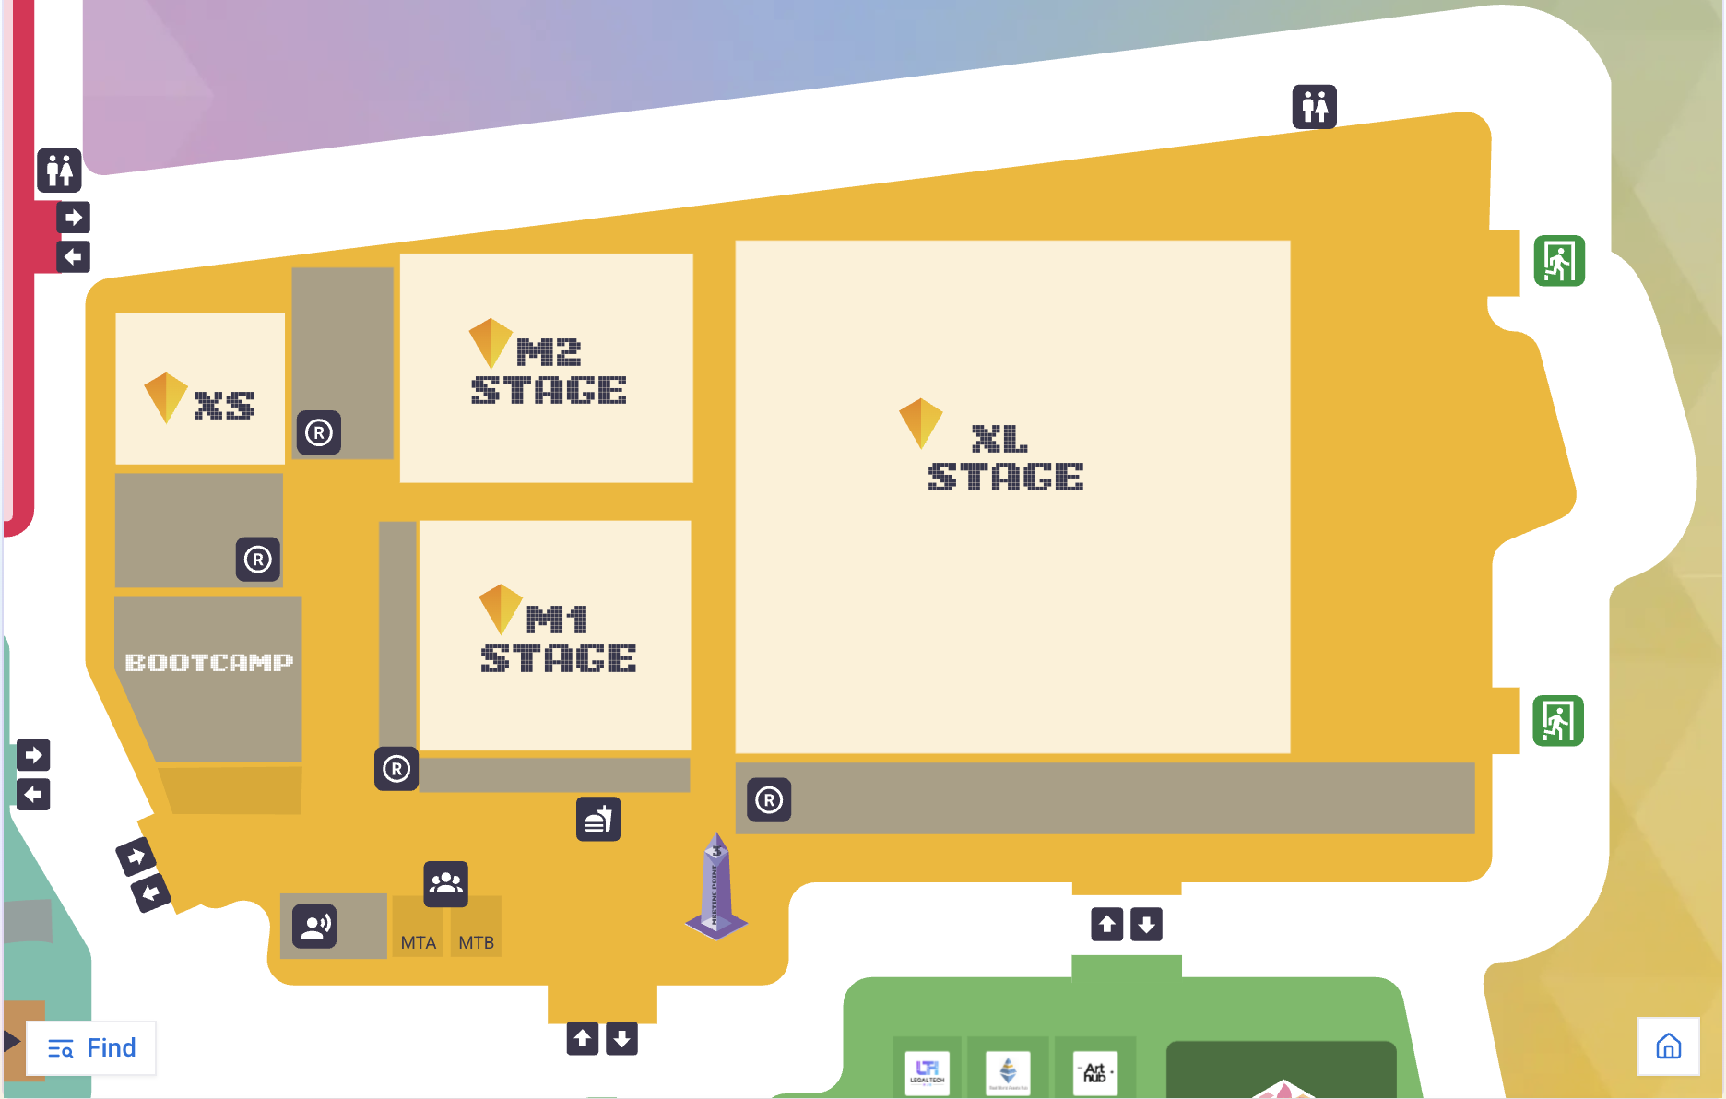
Venue Map
Solidity Summit Stage

Slide 7
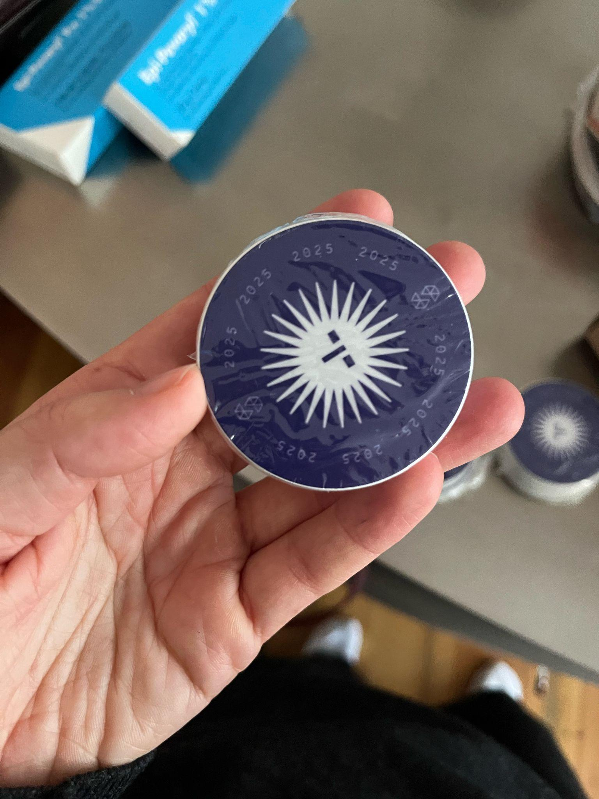


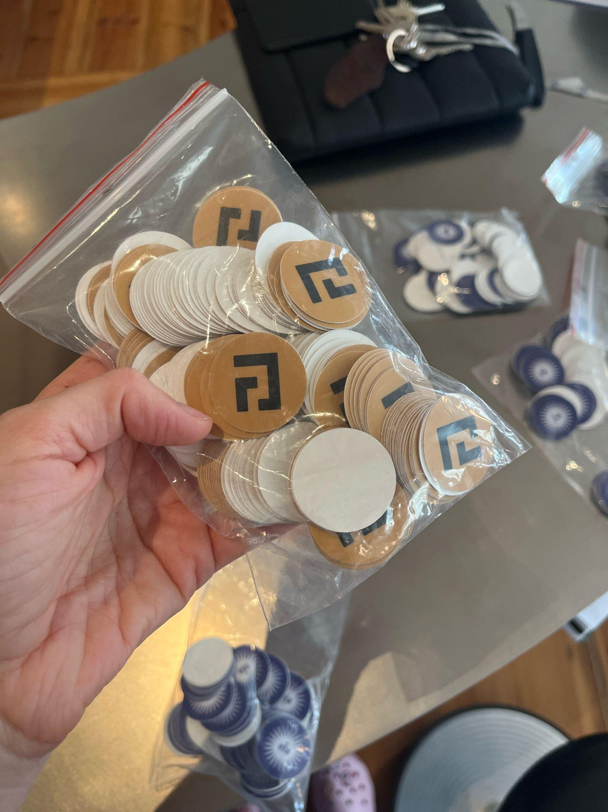
Grab your Solidity and Argot Swag!

Slide 8
Program overview.

Slide 9
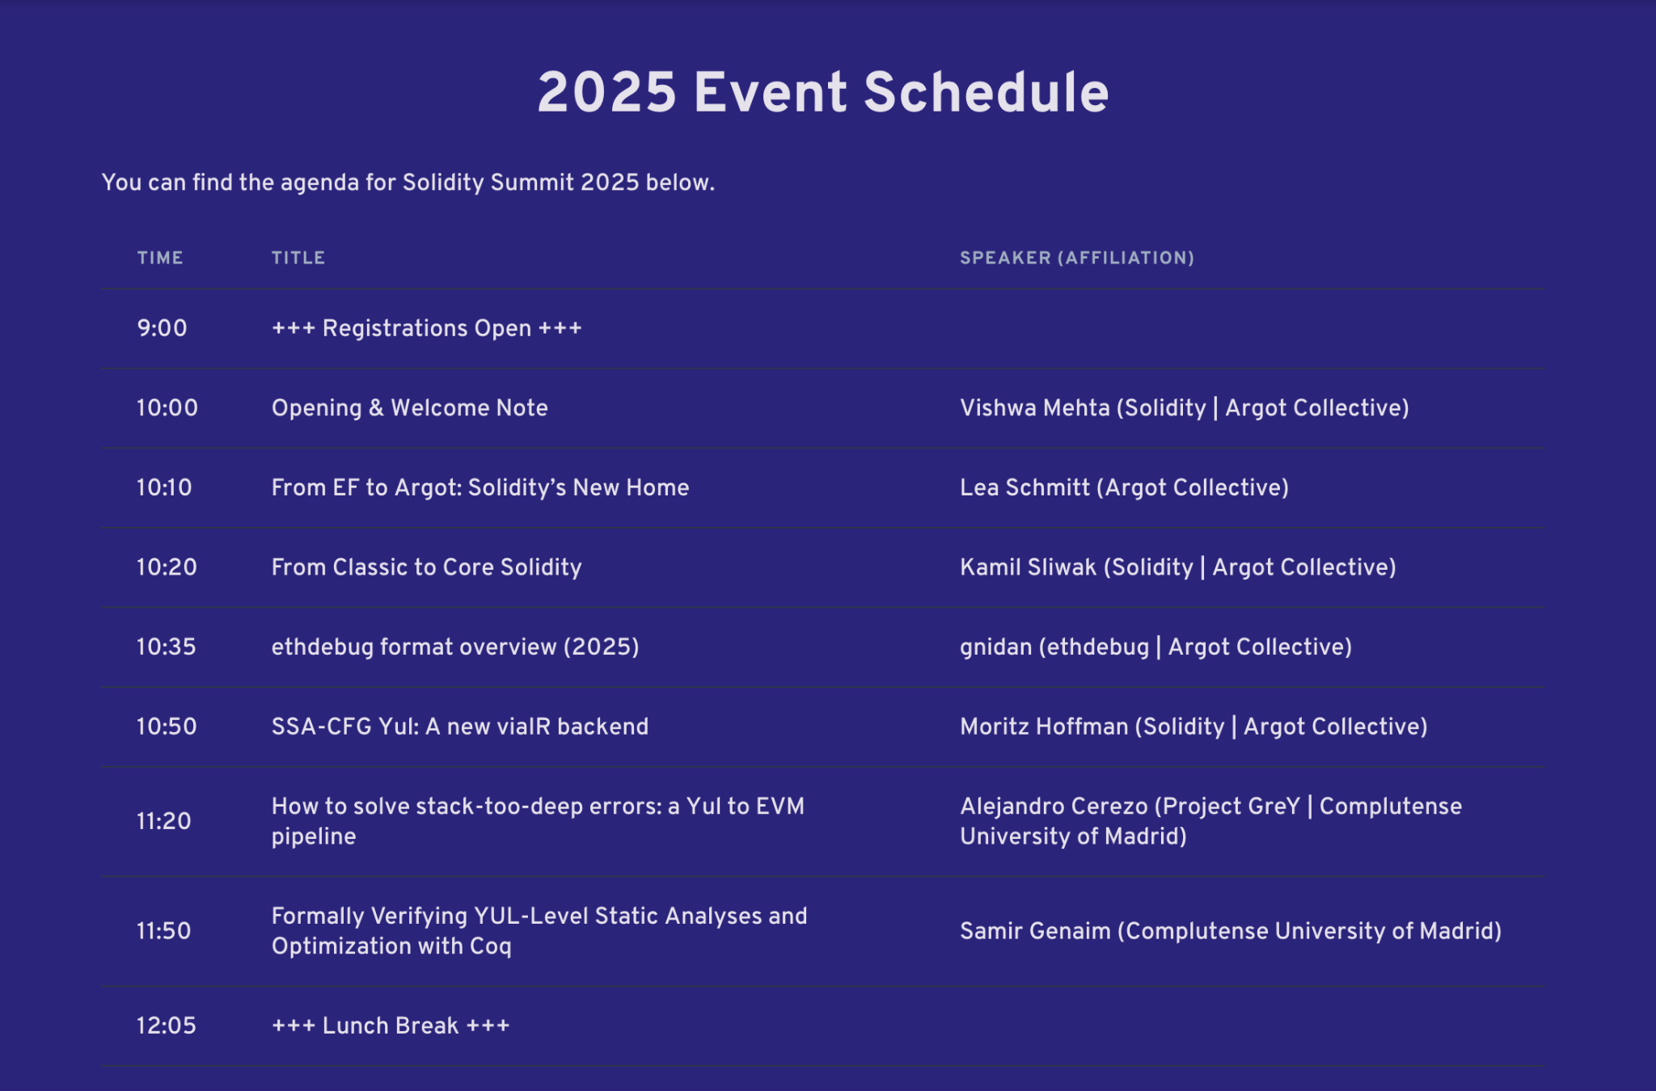

Slide 10
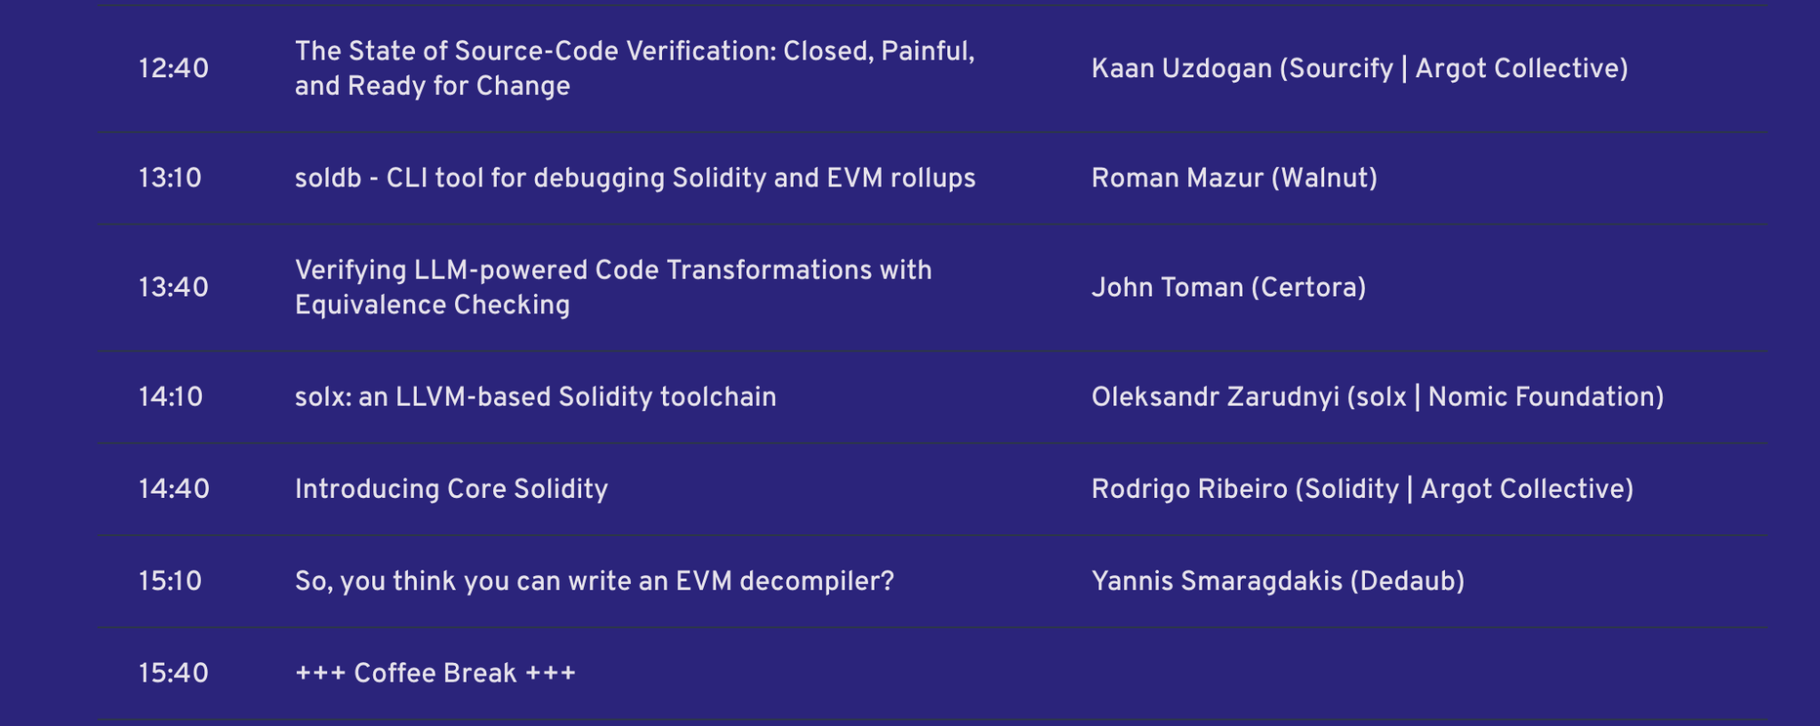

Slide 11
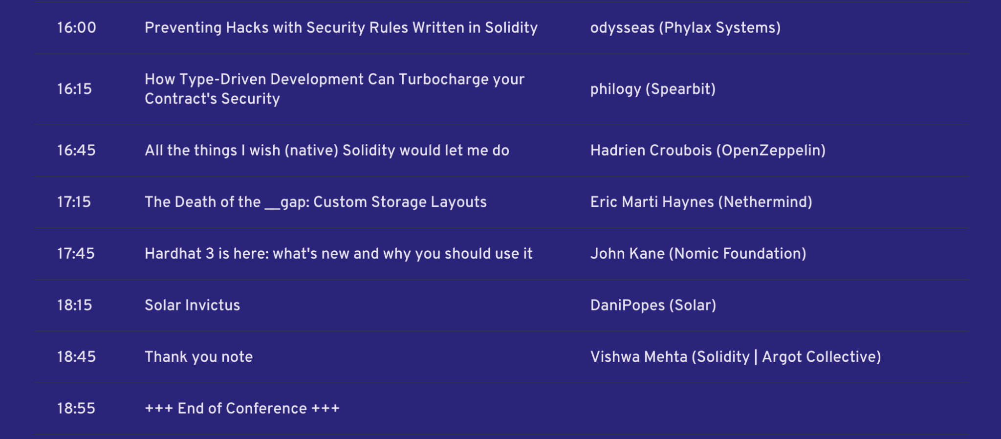

Slide 12

BREAK TIMINGS
“
Lunch break will be from 12:05 - 12:40 and
Coffee break will be from 15:40 - 16:00

Slide 13
Do’s at Solidity Summit
Don’ts at Solidity Summit
Talk loudly in the main hall
Use abusive or disrespectful language or gestures
Shill your project or token
Interrupt a speaker or MC on stage
Respect presenters and fellow attendees
Use the hangout area to have discussions
Ask questions and talk to as many team members/speakers as you can!
Have a great time!

Slide 14
Last but not least, have the best time today and share feedback with us:
- Twitter: @solidity_lang
- Forum: forum.soliditylang.org/
- In person, here, at Solidity Summit!

